Slide 2
/ɚ/

Slide 3
river

Slide 4
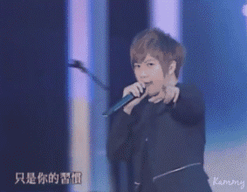
singer

Slide 5
summer

Slide 6
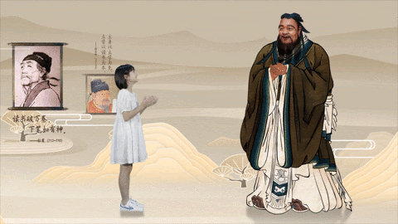
teacher
Confucius孔子

Slide 7
actor
Johnny Depp

Slide 8
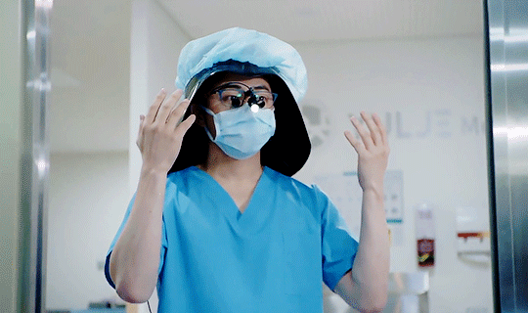
doctor

Slide 9
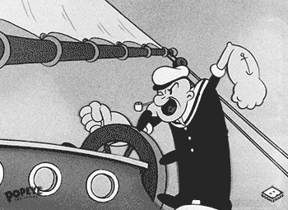
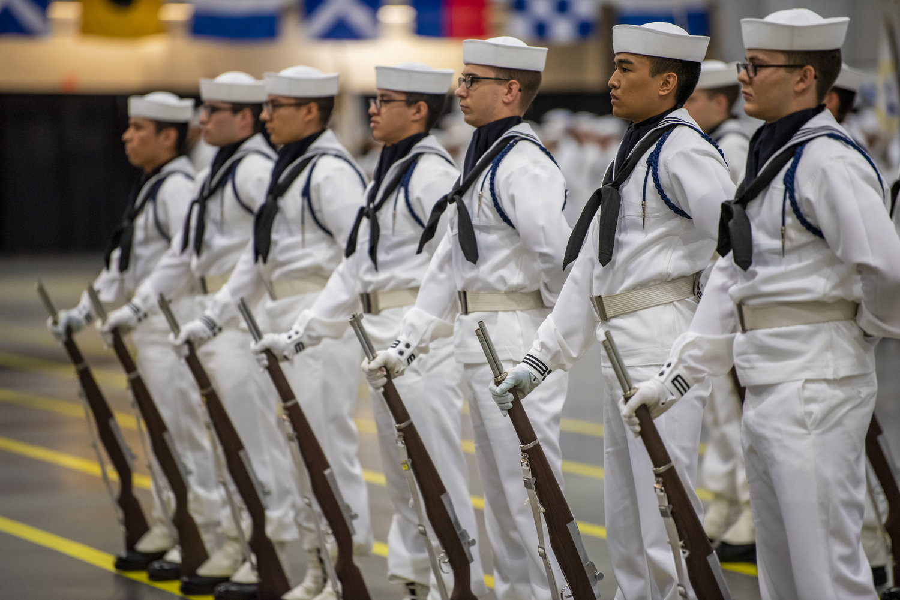
sailor
Popeye the Sailor Man

Slide 10
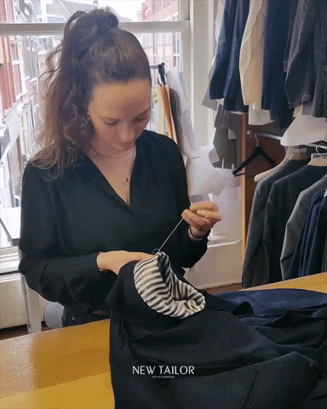
tailor

Slide 11
-er / -or /ɚ/ sound
river
singer
summer
teacher
actor
doctor
sailor
tailor

Slide 13
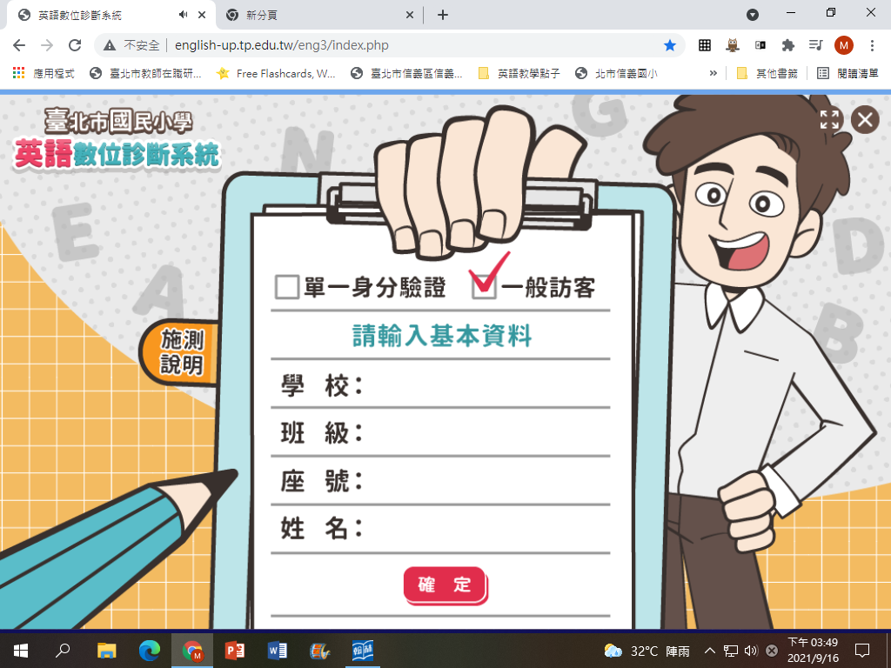
http://english-up.tp.edu.tw/eng3/index.php
XinYi
506
01
Mandy

Slide 14
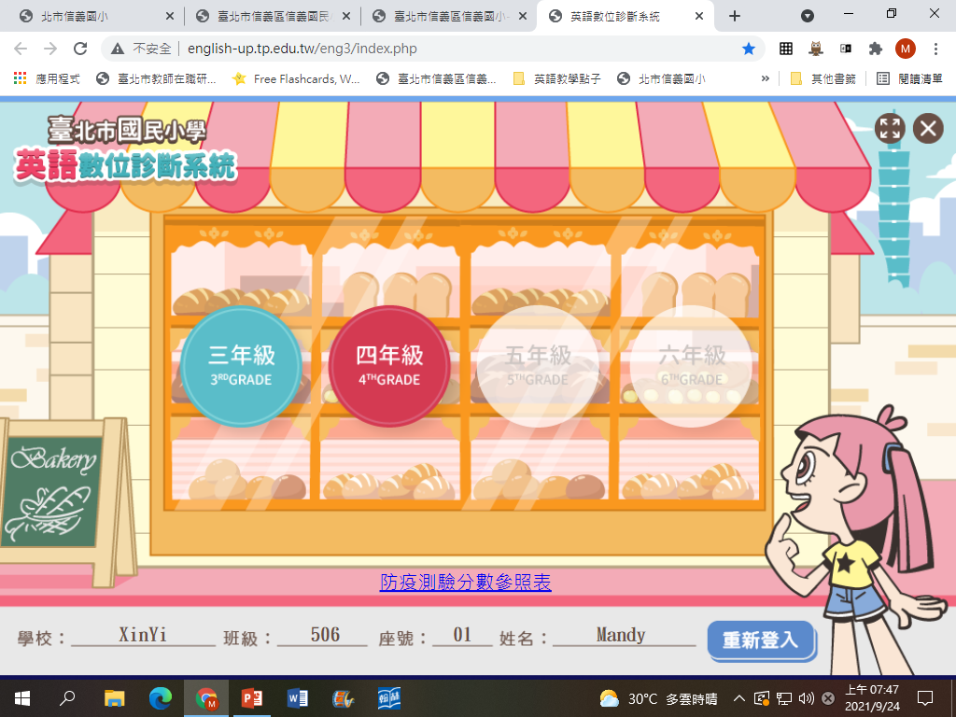

Slide 15
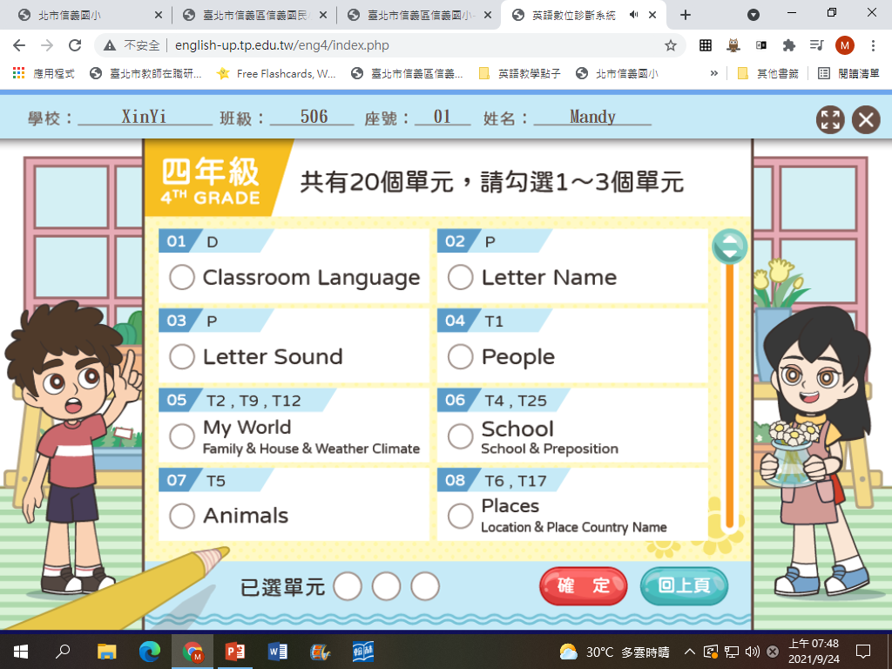
V
V
V

Slide 16
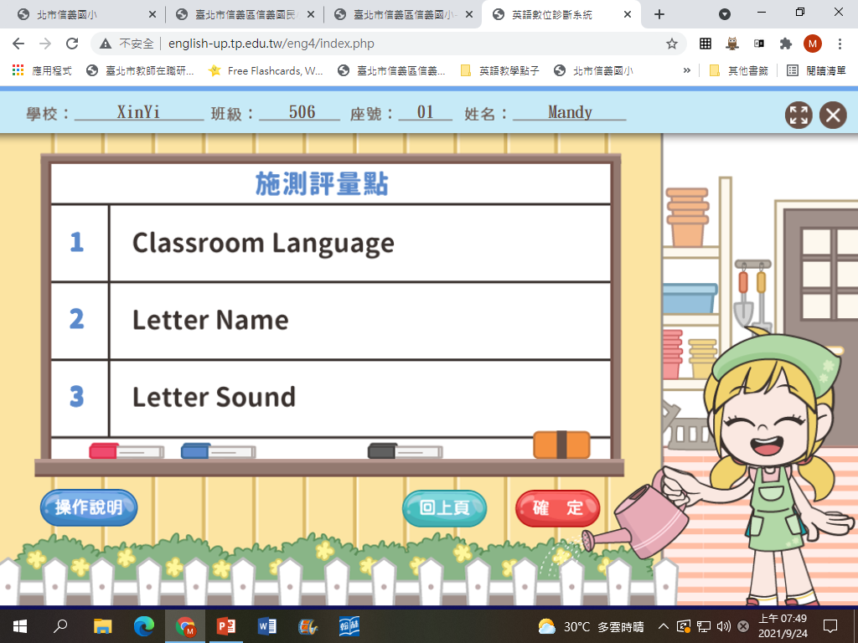

Slide 17
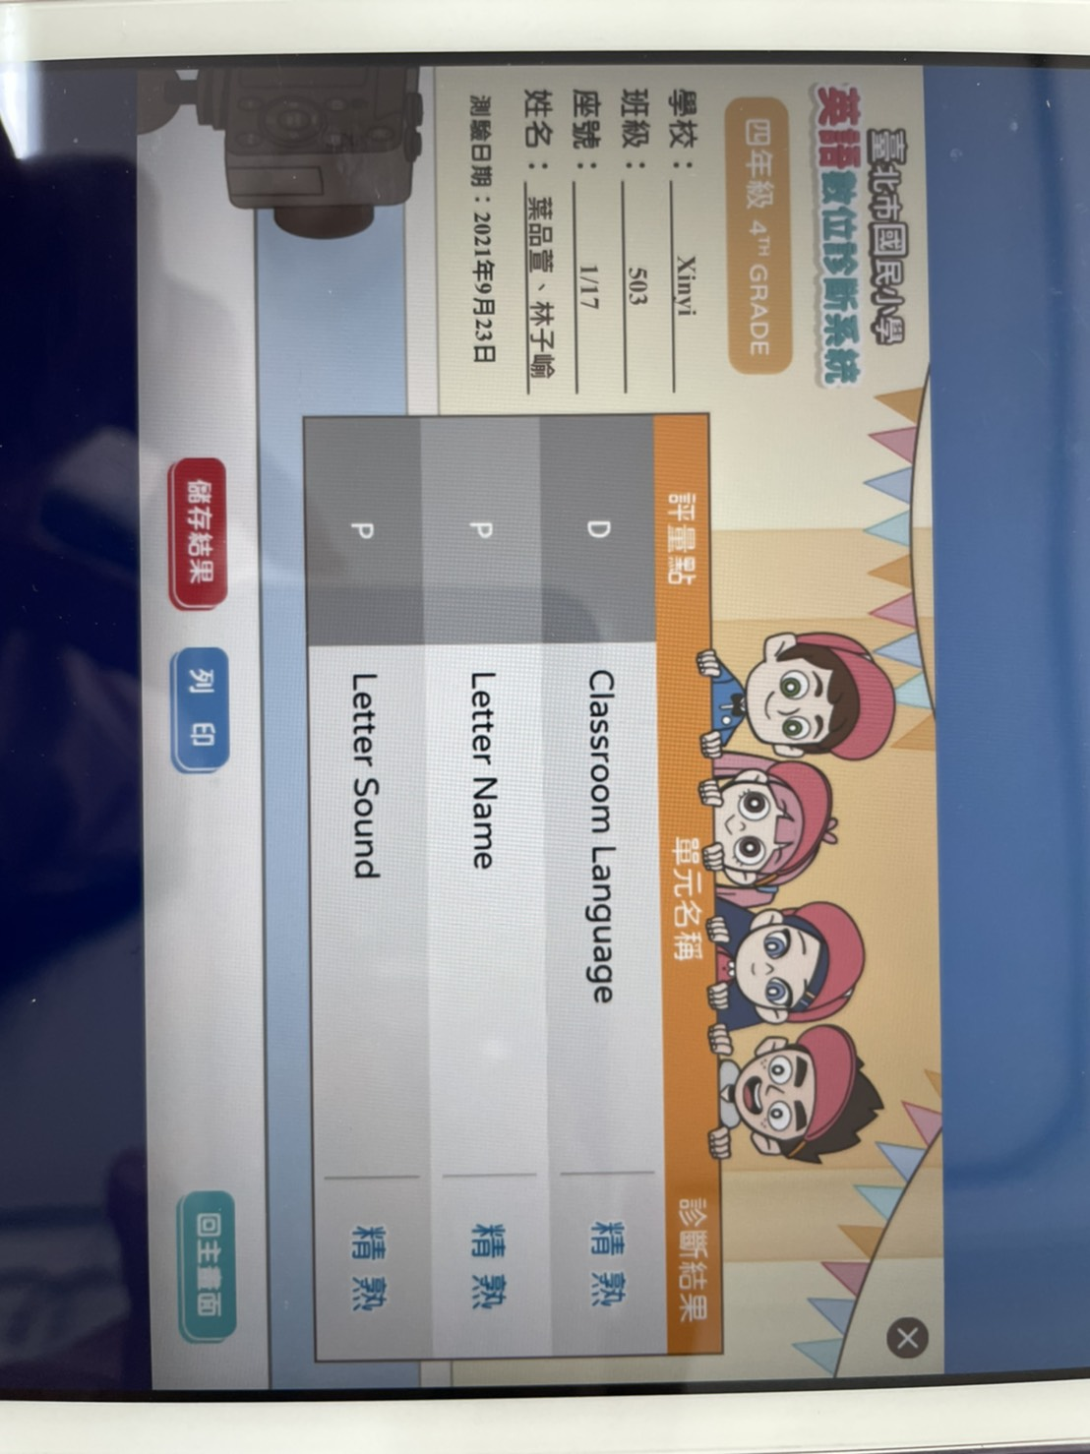

Slide 18
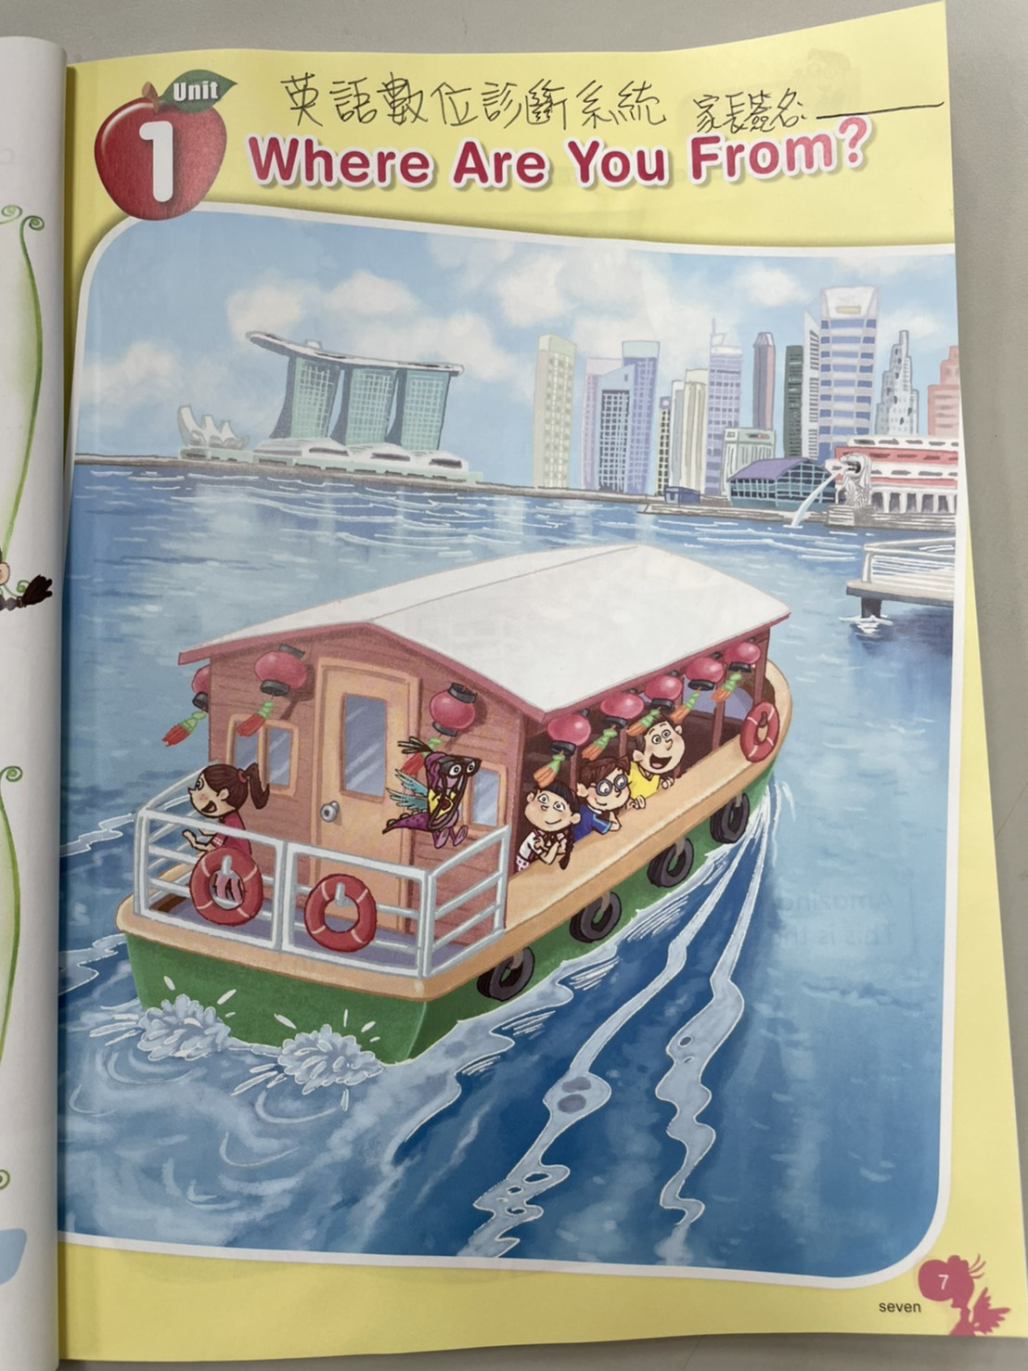
有上診斷系統練習答題的同學，可請家長簽名，下週英語課換印章!
連結在Mandy老師網頁

Slide 19
Leaderboard of Starter Unit Story Time
501 Hannah
505 Louis
502 Peter
504 Ila
504 Emily Kuo
502 Oscar
503 Naomi
501 Ben
504 Kathy
505 Howard
505 Lucy
501 Chilian
503 Arthur
504 Louis
505 Bella
502 Wayne
501 Anna
504 Alice
504 Leo
503 Miffy

Slide 20
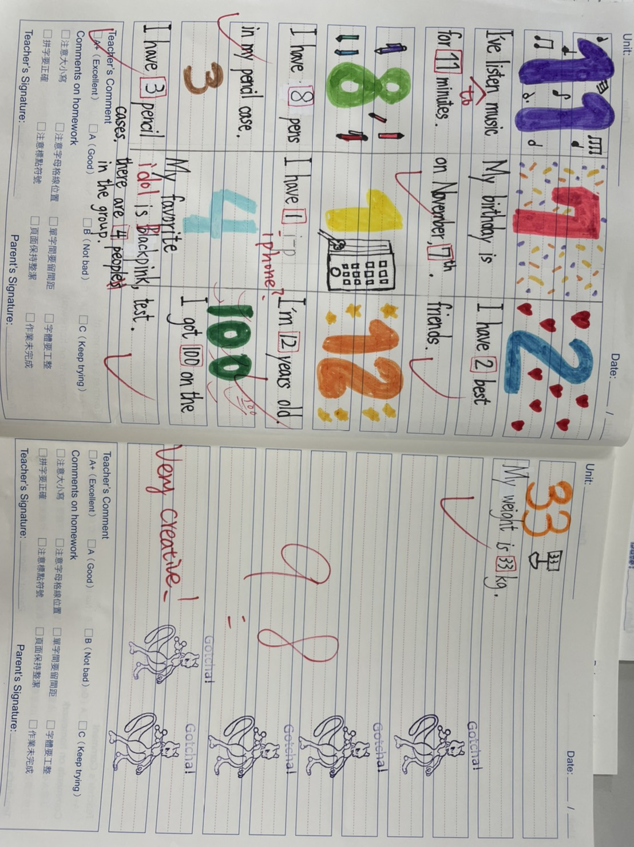

Slide 22
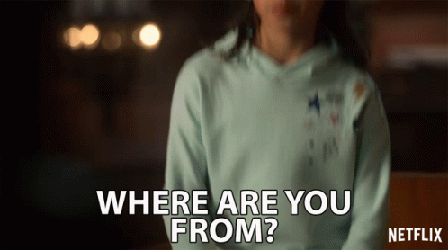
Where are you from?

Slide 23
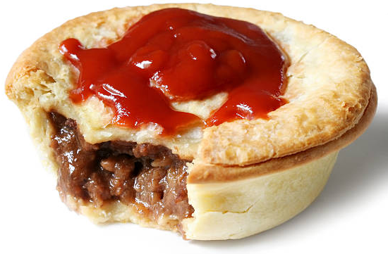
Australia
Brisbane
Sydney
Canberra
Melbourne
Chris Hemsworth

Slide 24
Let’s draw a word tree!

Slide 25
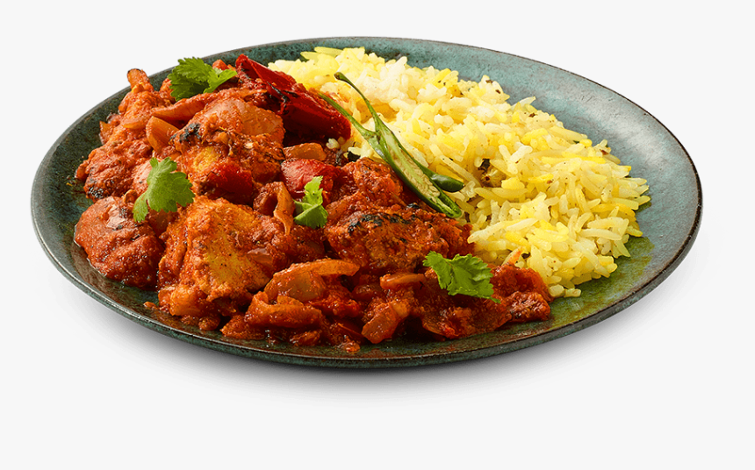
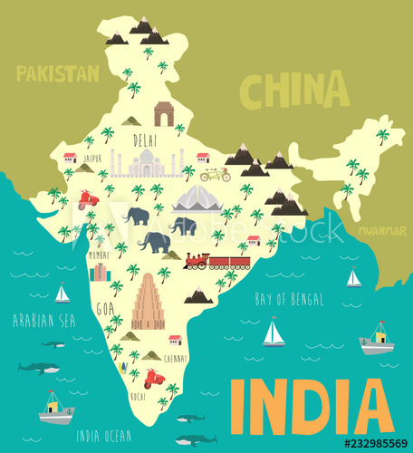
India
New Delhi
Mumbai
Kolkata
Bollywood / Aamir Khan

Slide 26
Let’s draw a word tree!

Slide 27
Japan
Demon Slayer

Slide 28
Let’s draw a word tree!

Slide 29
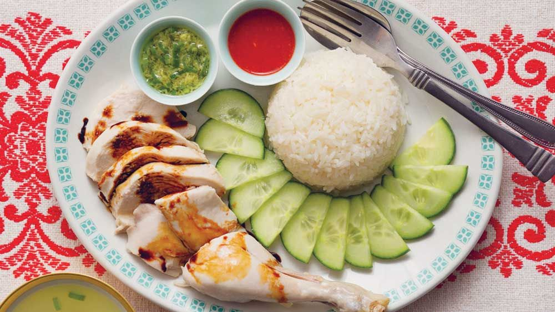
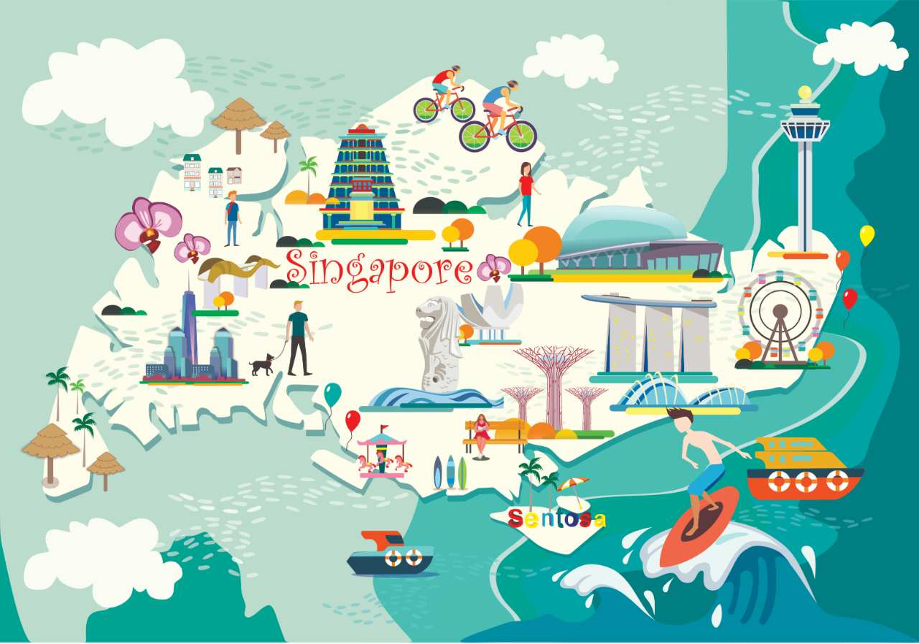
Singapore
Hainanese
chicken rice
Sng Ee Tze
JJ Lin

Slide 30
Let’s draw a word tree!

Slide 31
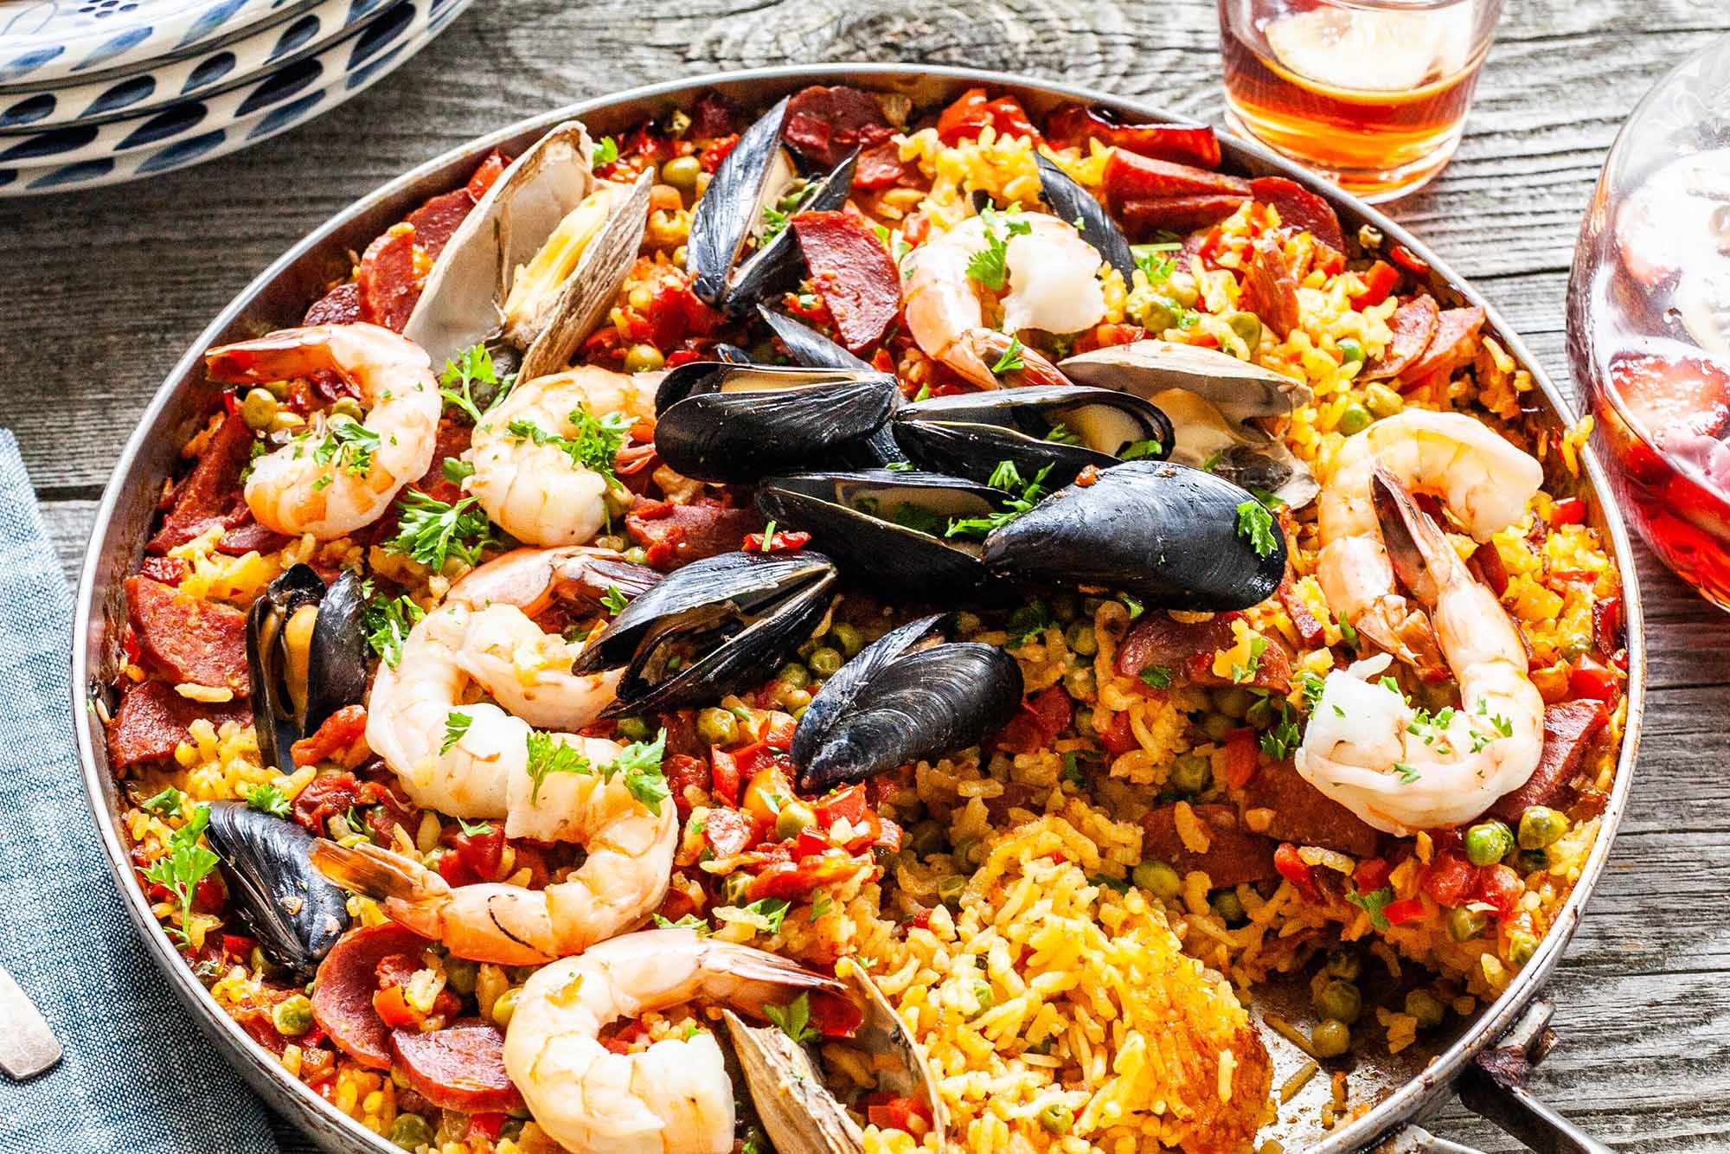
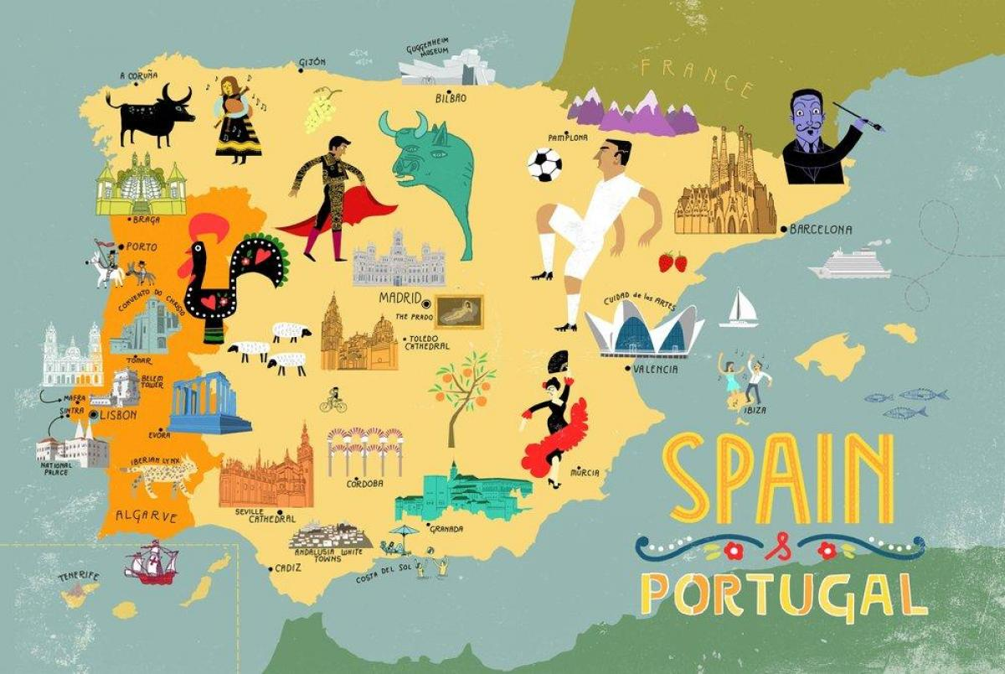
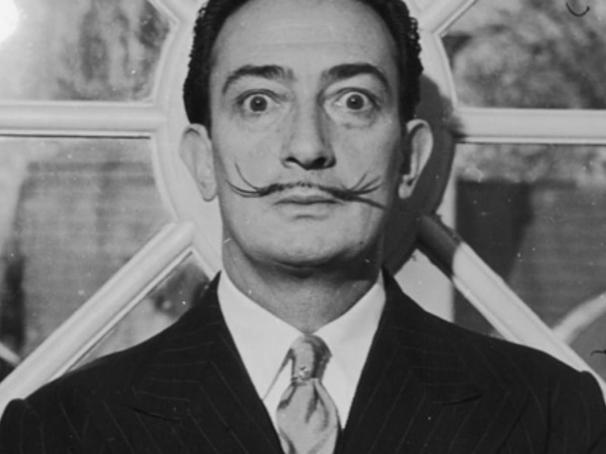
Spain
Paella
Barcelona
Madrid
Valencia
Salvador Dali

Slide 32
Let’s draw a word tree!

Slide 33
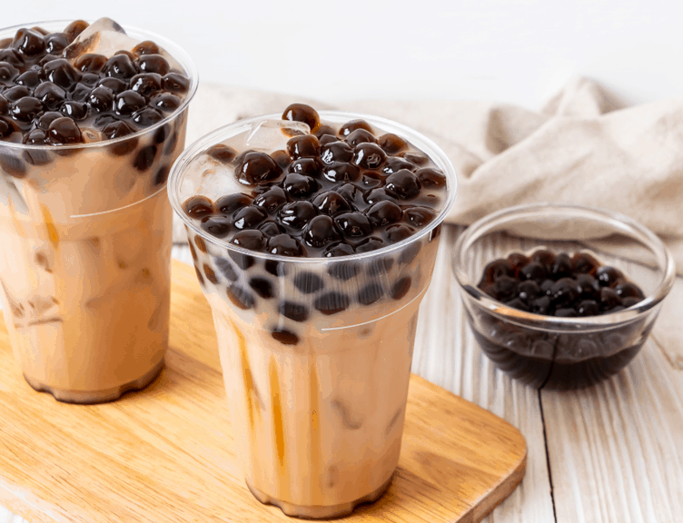
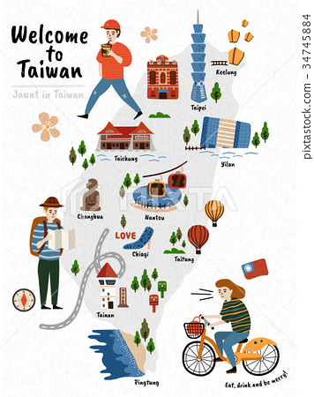
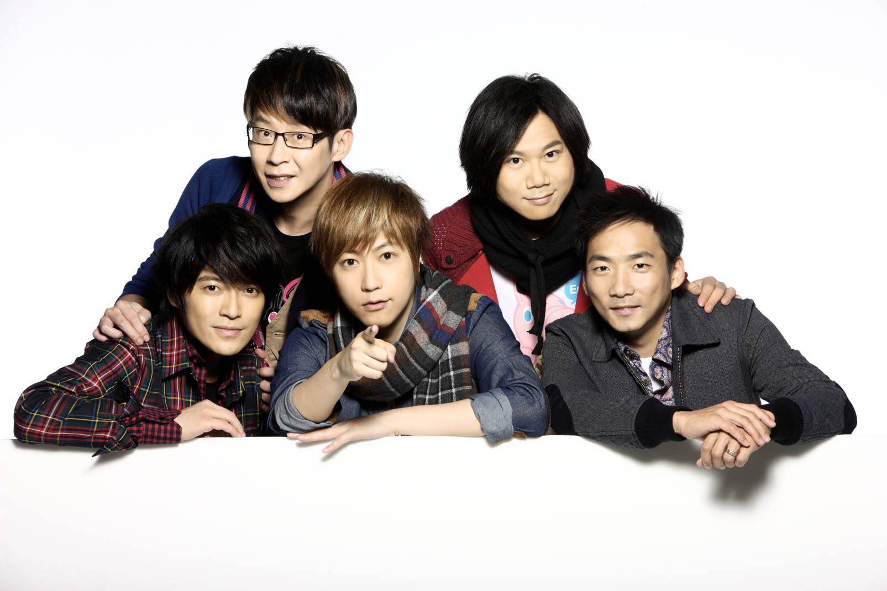
Taiwan
Mayday

Slide 34
Let’s draw a word tree!

Slide 35
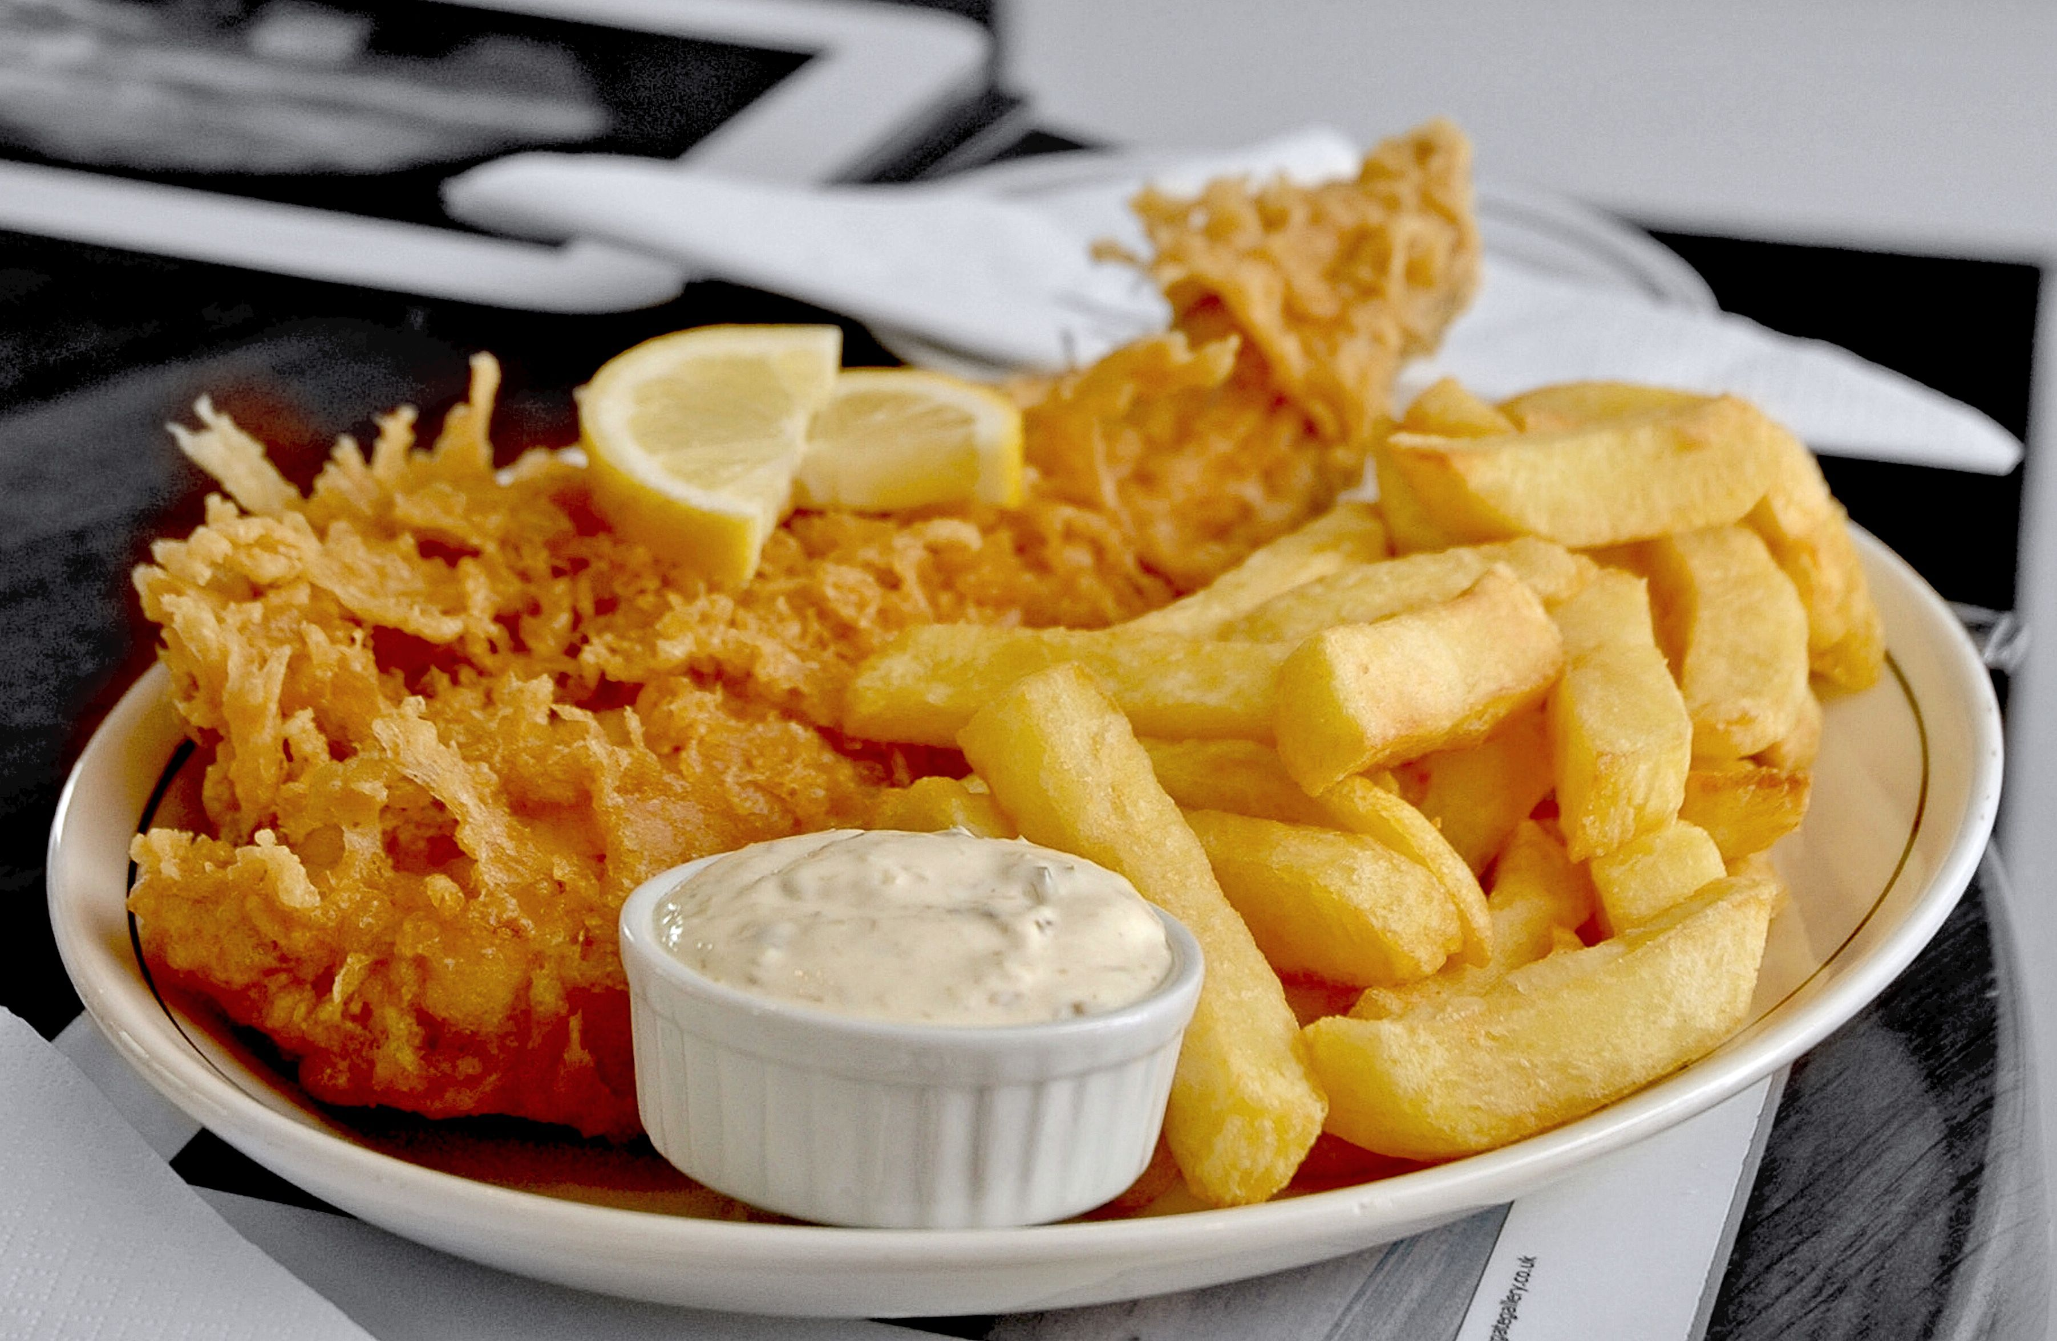
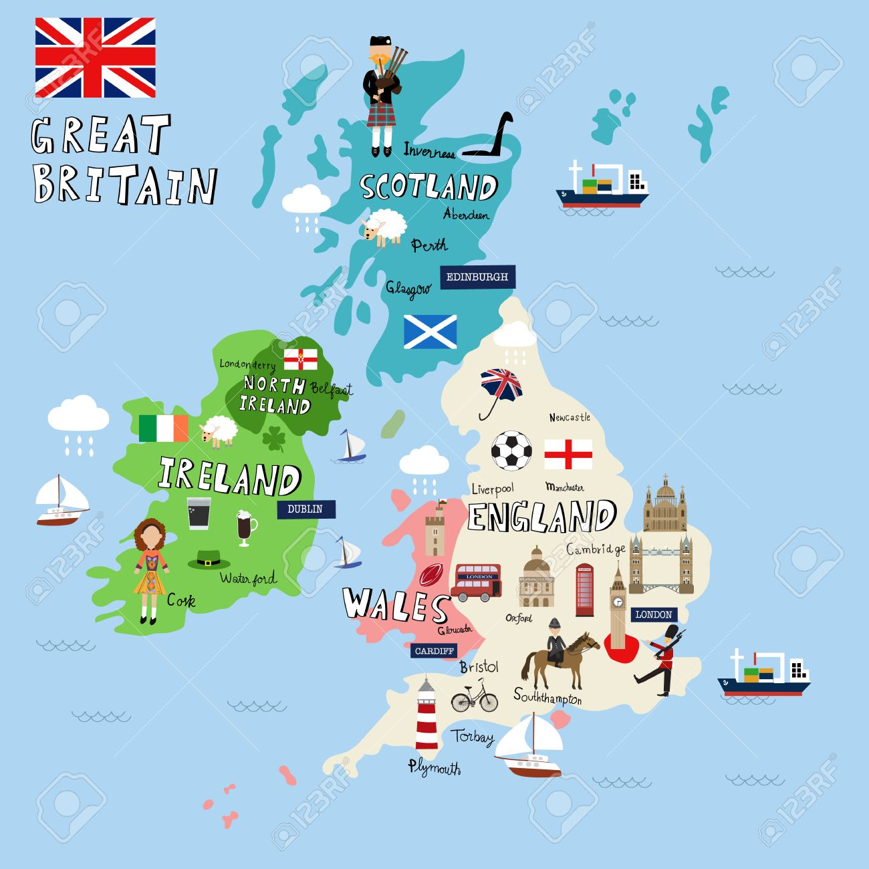
the UK/ United Kingdom/
England/ Great Britain
Sherlock Holmes

Slide 36
Let’s draw a word tree!

Slide 37
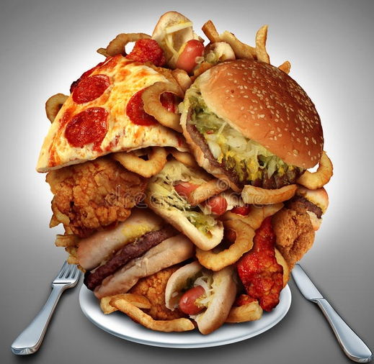
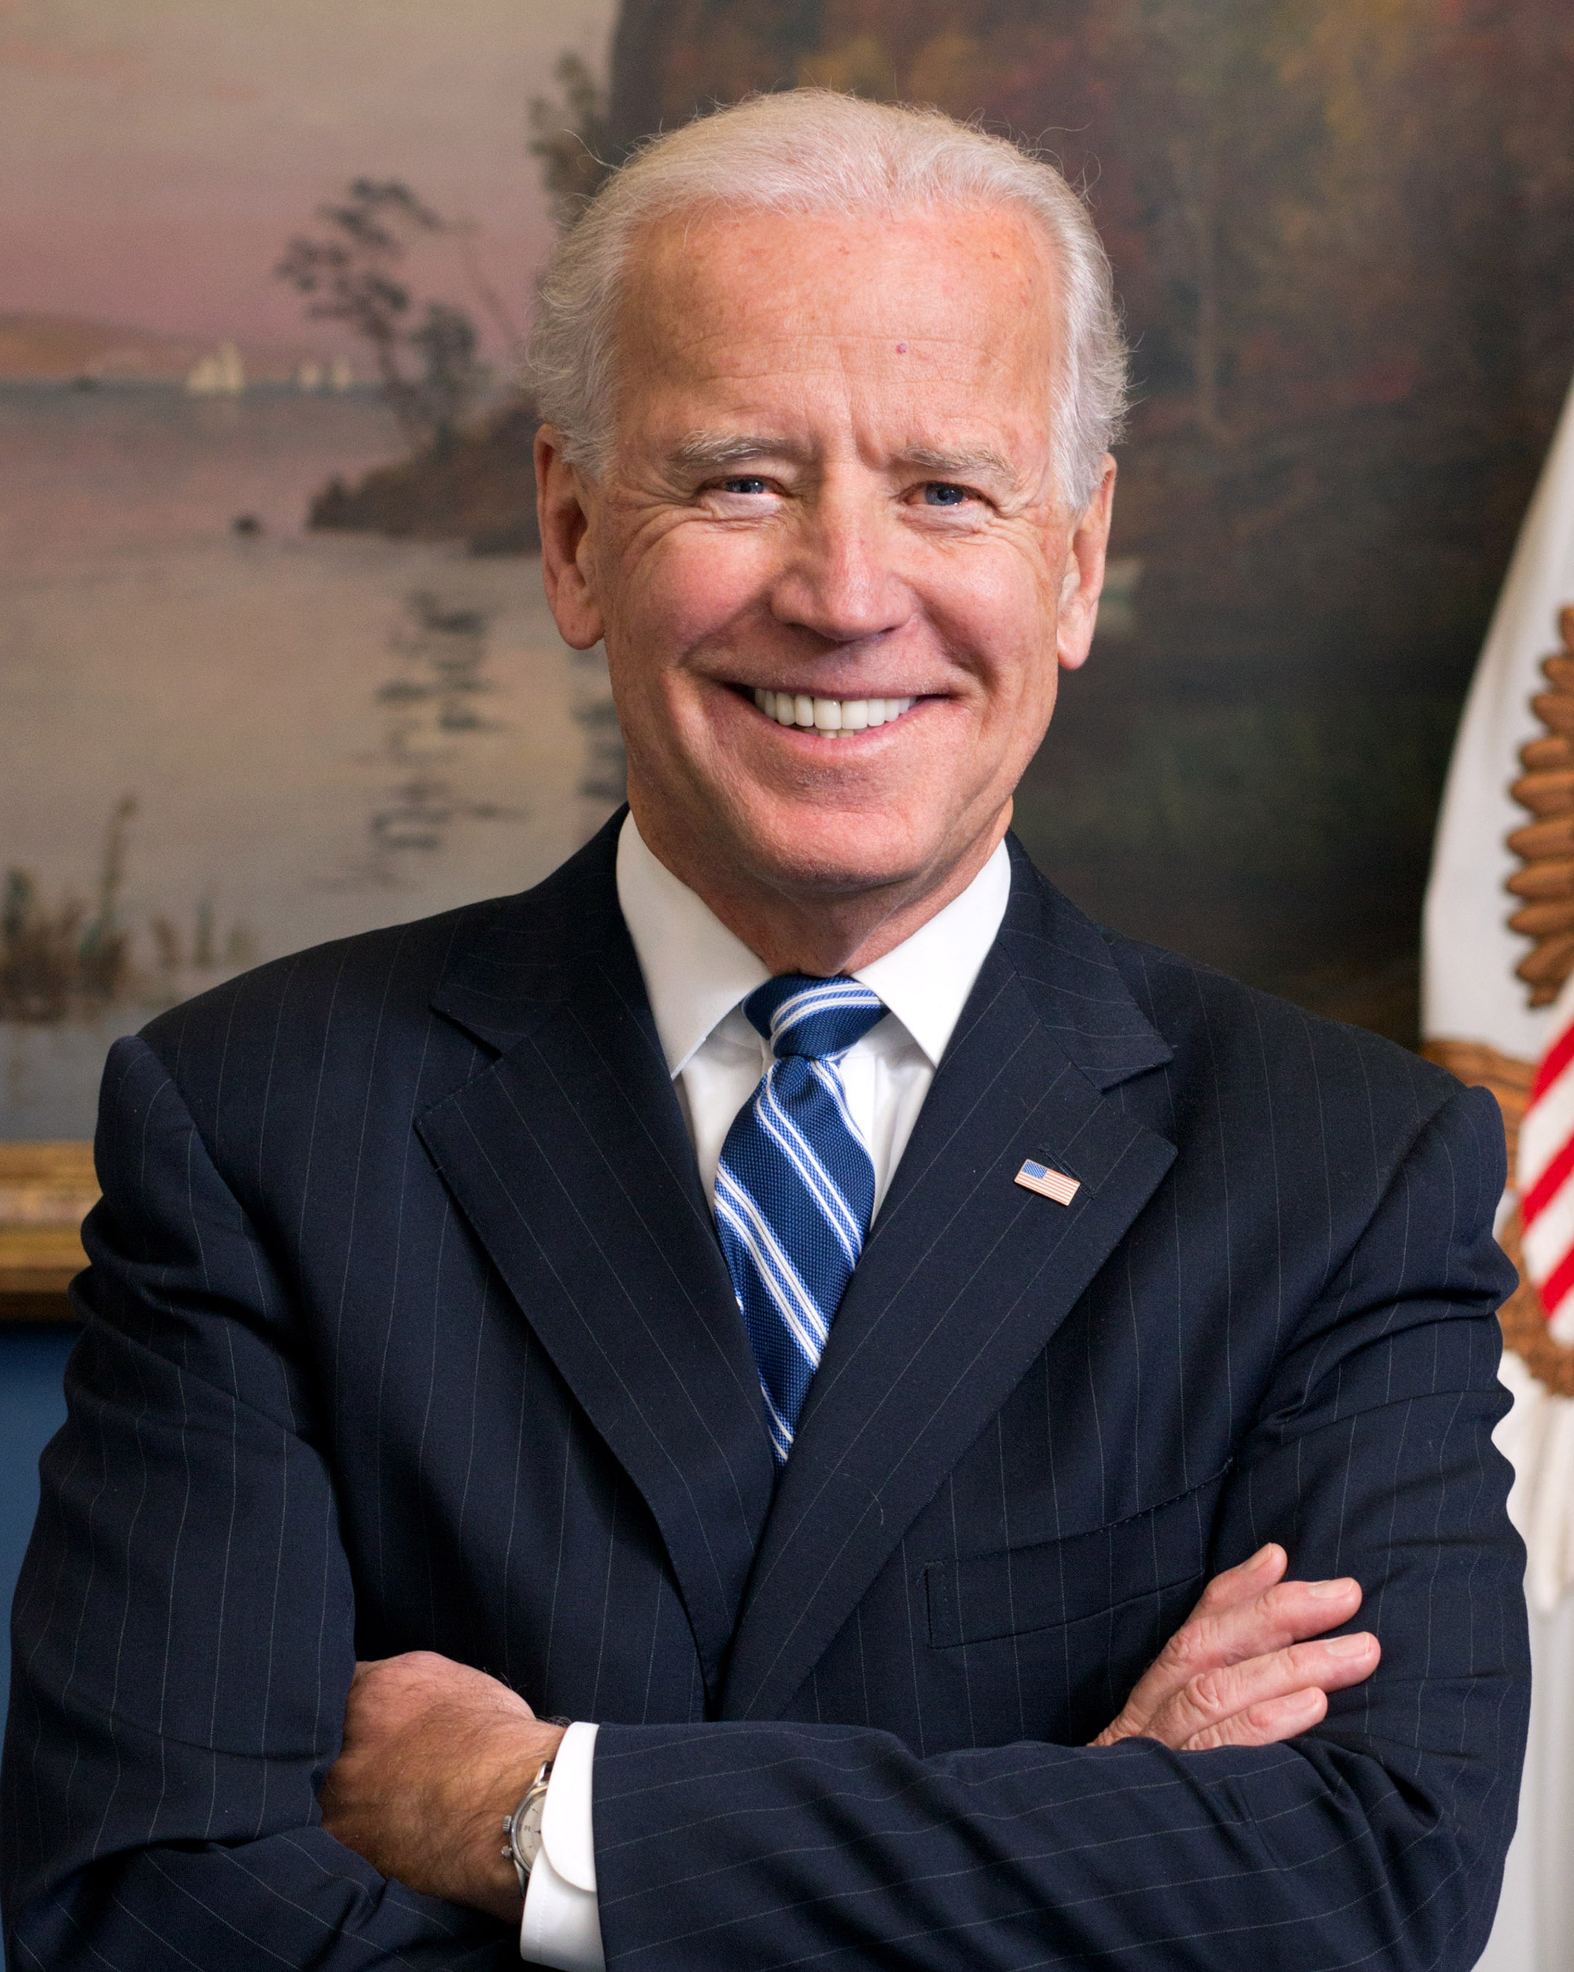
the USA/ the US/America/ United States of America
New York
Washington DC
San Francisco
Joe Biden

Slide 38
Let’s draw a word tree!

